Slide 1
Software Testing and Quality Assurance
Testing State Transition Diagrams

Slide 2
Outline
Generating State Transition Diagrams
State-Transition Tables
Creating Test Cases

Slide 3
State-Transition Testing Example
State-Transition diagrams are an excellent tool to capture certain types of system requirements and to document internal system design.
These diagrams document the events that come into and are processed by a system as well as the system's responses.

Slide 4
Reservation System Example
1- Make a reservation
Provide information including departure and destination cities, dates, and times.
A reservation agent uses that information to make a reservation.
At that point, the Reservation is in the Made state.
The system creates and starts a timer.
If this timer expires before the reservation is paid for, the reservation is cancelled by the system.

Slide 5
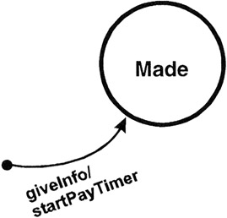
Reservation System Example
giveInfo, is an event that comes into the system from the outside world.
The command after the "/" denotes an action of the system; in this case startPayTimer.

Slide 6
Reservation System Example
When money is paid, through initiation of the PayMoney action, the system goes into the “Paid” state.
  Events may have parameters associated with them. For example, Pay Money may indicate Cash, Check, Debit Card, or Credit Card
When the ticket is printed, the system goes into the Ticketed State
Upon boarding the plane, the customer gives the boarding pass along with the ticket, which signals that the ticket has been Used.
  Anything else after this state?

Slide 7
Reservation System Example
If the Reservation is not paid on time, the PayTimer expires and the Reservation is cancelled for non-payment.
A reservation may become cancelled if the customer wishes to do so.
  This can happen prior to payment or after payment.
  If after payment, a refund needs to be generated.
  If the customer had the tickets with him, a refund cannot be given unless the printed ticket itself is returned to the agent.
    This introduces one new notational element—square brackets [] that contain a conditional that can be evaluated either True or False.
      This conditional acts as a guard allowing the transition only if the condition is true.

Slide 8
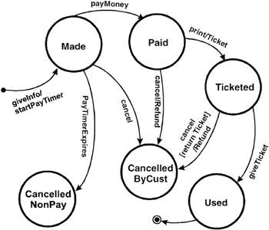
State Transition Diagram of the Reservation System

Slide 9
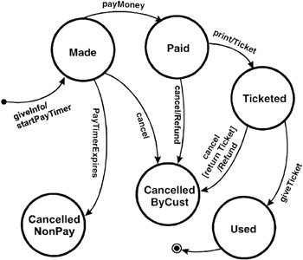
8- Customer cancels after receiving the ticket (cont.)
Cancellation from the Ticketed state

Slide 10
State-Transition Tables
State-transition tables may be easier to use in a complete and systematic manner.
State-transition tables consist of four columns—Current State, Event, Action, and Next State.
Build the state-transition table as follows
For each state of the system
For each event/trigger of the system
Find the corresponding (Action, Next State) [if any]
Document (state, event, action, next state)

Slide 11
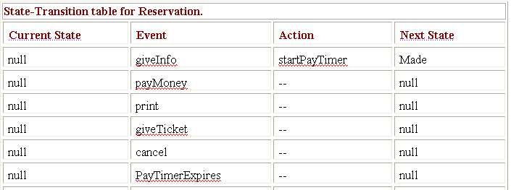

Slide 12
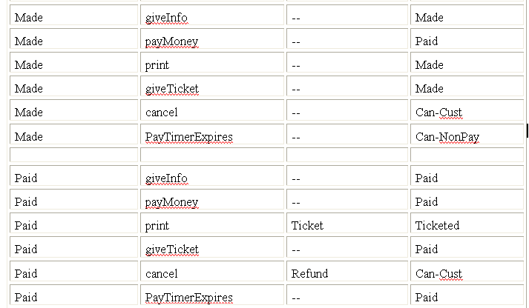

Slide 13
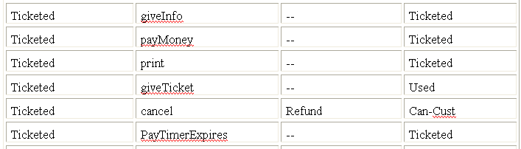
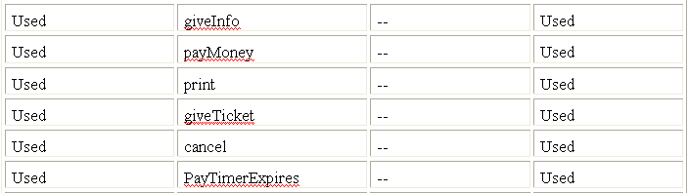

Slide 14
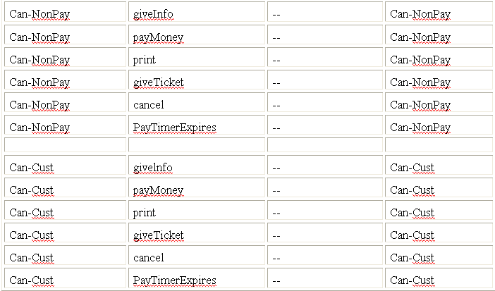

Slide 15
Table format 2
State/Event | Give Info | Pay Money | Print | Give Ticket | Cancel | PayTimer Expires
Null | Made
Made |  | Paid |  |  | Can-Cust | Can-NonPay
Paid |  |  | Ticketed |  | Can-Cust
Ticketed |  |  |  | Used | Can-Cust
Used
Can-NonPay
Can-Cust
Note : Actions not included

Slide 16
State-Transition Tables (Cont.)
The advantage of a state-transition table is that it lists all possible state-transition combinations, not just the valid ones.
When testing critical, high-risk systems such as avionics or medical devices, testing every state-transition pair may be required, including those that are not valid.
Creating a state-transition table often unearths combinations that were not identified, documented, or dealt with in the requirements. It is highly beneficial to discover these defects before coding begins.

Slide 17
State-Transition Tables (Cont.)
Using a state-transition table can help detect defects in implementation that enable invalid paths from one state to another.
The disadvantage of such tables is that they become very large very quickly as the number of states and events increases.
In addition, the tables are generally sparse; that is, most of the cells are empty.

Slide 18
Creating Test Cases
Create a set of test cases such that all states are "visited" at least once under test. The set of three test cases shown below meets this requirement. Generally this is a weak level of test coverage.

Slide 19
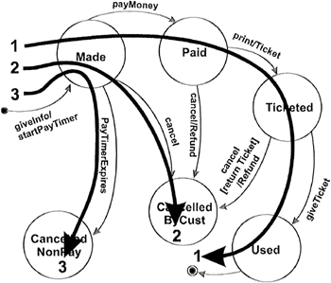
A set of test cases that "visit" each state

Slide 20
Creating Test Cases (Cont.)
2. Create a set of test cases such that all events are triggered at least once under test. Note that the test cases that cover each event can be the same as those that cover each state. Again, this is a weak level of coverage.

Slide 21

A set of test cases that trigger all events at least once

Slide 22
Creating Test Cases (Cont.)
3. Create a set of test cases such that all paths are executed at least once under test.
While this level is the most preferred because of its level of coverage, it may not be feasible.
If the state-transition diagram has loops, then the number of possible paths may be infinite.
For example, given a system with two states, A and B, where A transitions to B and B transitions to A. A few of the possible paths are:
    A→B
    A→B→A
    A→B→A→B→A→B
    A→B→A→B→A→B→A
    ...
    and so on forever.

Slide 23
3. Create a set of test cases such that all paths are executed at least once under test (Cont.)
Testing of loops such as this can be important if they may result in accumulating computational errors or resource loss (locks without corresponding releases, memory leaks, etc.).

Slide 24
Creating Test Cases (Cont.)
4. Create a set of test cases such that all transitions are exercised at least once under test. This level of testing provides a good level of coverage without generating large numbers of tests. This level is generally the one recommended.

Slide 25
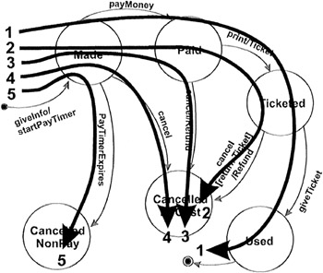
A set of test cases that trigger all transitions at least once

Slide 26
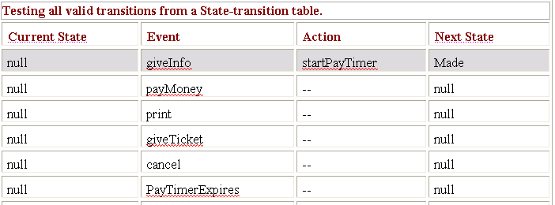
4. A set of test cases that trigger all transitions at least once (Cont.)
Test cases can also be read directly from the state-transition table. The gray rows in the following table show all the valid transitions.

Slide 27
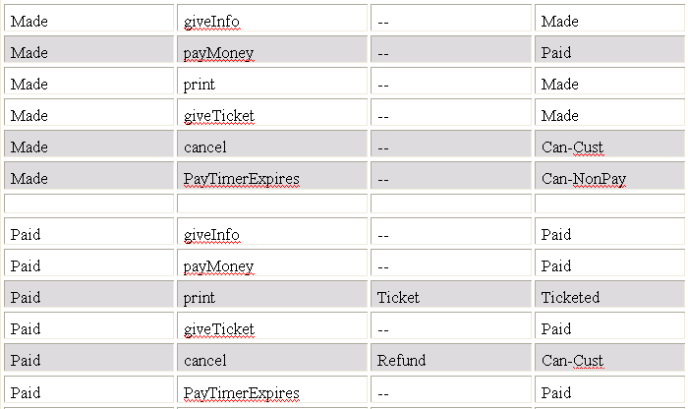

Slide 28
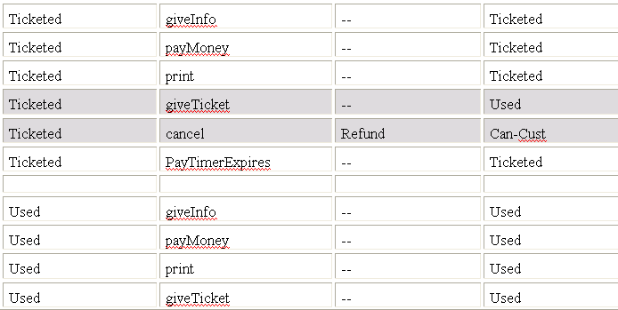


Slide 29
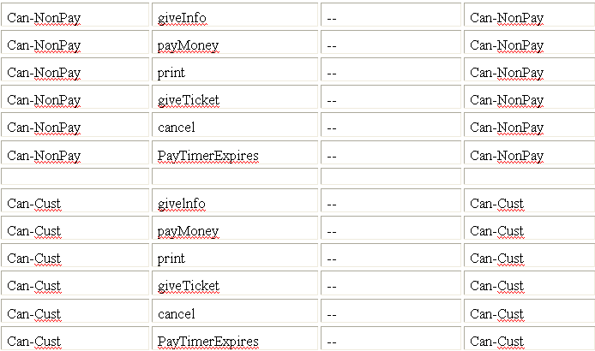

Slide 30
State-Transition Testing (Cont.)
In addition, depending on the system risk, you may want to create test cases for some or all of the invalid state/event pairs to make sure the system has not implemented invalid paths.
Applicability and Limitations
  State-Transition diagrams are excellent tools to capture certain system requirements, namely those that describe states and their associated transitions. These diagrams then can be used to direct our testing efforts by identifying the states, events, and transitions that should be tested.
  State-Transition diagrams are not applicable when the system has no state or does not need to respond to real-time events from outside of the system.
  An example is a payroll program that reads an employee's time record, computes pay, subtracts deductions, saves the record, prints a paycheck, and repeats the process.

Slide 31
Key Points
State-Transition diagrams direct our testing efforts by identifying the states, events, actions, and transitions that should be tested. Together, these define how a system interacts with the outside world, the events it processes, and the valid and invalid order of these events.
A state-transition diagram is not the only way to document system behaviour. They may be easier to comprehend, but state-transition tables may be easier to use in a complete and systematic manner.
The generally recommended level of testing using state-transition diagrams is to create a set of test cases such that all transitions are exercised at least once under test.
In high-risk systems, you may want to create even more test cases, approaching all paths if possible.

